Slide 1

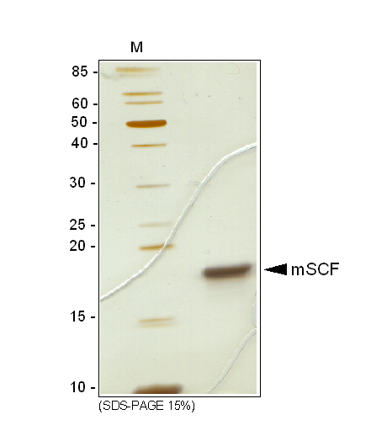
ReliaTech GmbH
Recombinant mouse SCF (E. coli)
(Cat# M30-010S/-010/-011)
Fig. 1: SDS-PAGE analysis of recombinant mouse SCF produced in E. coli. Sample was loaded in 15 SDS-polyacrylamide gel under reducing conditions and stained with Silver stain.
http://www.reliatech.de / orders@reliatech.de

